Slide 1
AUTOTRACK
AUTO MAINTENANCE TRACKER
MSSE 696 SOFTWARE ENGINEERING PRACTICUM 2
LAUREN MALONE

Slide 2
Application Overview
Solution for tracking auto maintenance
Simple CRUD, full stack web application
Securely hosted in the cloud
Rapid prototype design, iterative and incremental

Slide 3
Use Cases

Slide 4






Application Architecture

Slide 5
Application Security

Slide 6
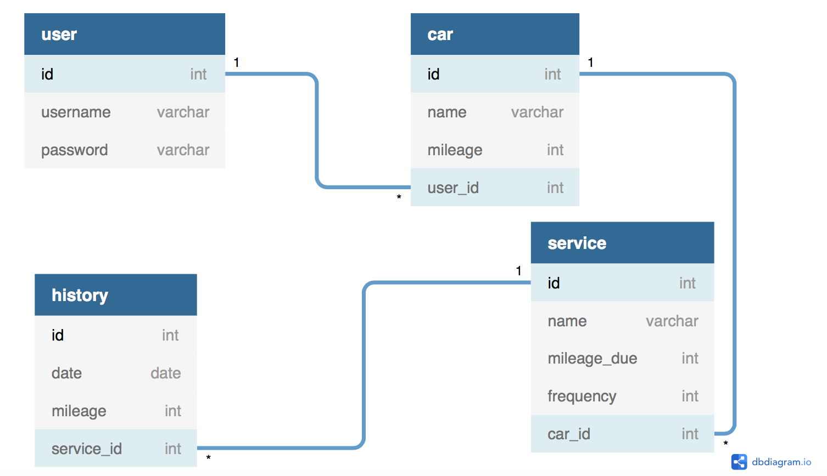
Database Design

Slide 7
Lessons Learned
Document in more detail than I think is necessary
Prioritize automation
Work on one feature at a time
Think it through first
I can figure it out!

Slide 8
AUTOTRACK DEMO

